Slide 1


Chapter 2
Data translation and analysis
of Satellite

Slide 2



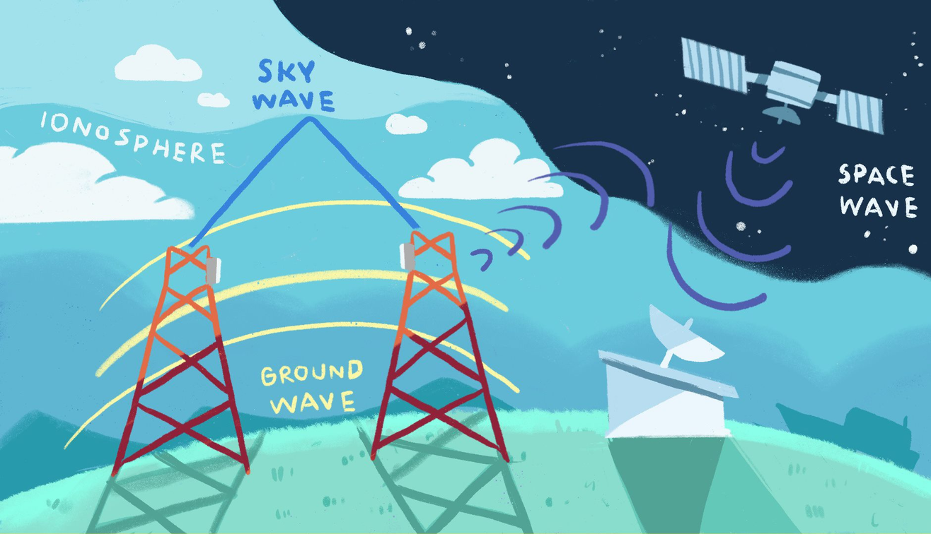


How can earth station communicate with satellite?
Ground stations can communicate with satellites through electromagnetic waves. It uses the radio frequency band between 0.3GHz - 40 GHz and converts the data into electromagnetic waveforms and sends it through space to satellites.
Center of Excellence in AI and Emerging Technology

Slide 3
Characteristics of data from satellite images
The operation of the remote sensing instrument's scanning system is similar to that of today's digital cameras. The difference is that a digital camera stores an image consisting of multiple points of view from a single shot. Meanwhile, the scanning system of the measuring instrument collects information about the environment into small image points called pixel. Each pixel has a numerical value that is the average irradiance value or brightness value of the area within the pixel. Then, the information from each pixel obtained is assembled into a complete image later. The area size of the pixel affects the details of the image. As the area of the image spots decreases, the details of the image will increase.
Analog data is data that shows the intensity of radiation that is continuous throughout the study area, such as aerial photographs. (which has not yet been converted into a digital image)
Digital data is information showing the intensity of radiation, which is divided into smaller levels for storage called bits. n bits of data are divided into 2n intensity levels. However, general images are usually divided into 256 intensity levels. (called 8-bit data)
Center of Excellence in AI and Emerging Technology

Slide 4
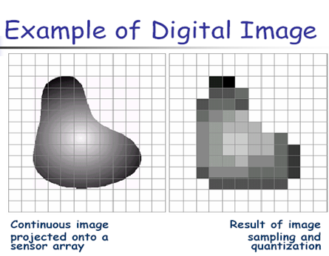
Characteristics of data from satellite images
Numerical data obtained from remote sensing is usually stored in two important formats
Digital images, such as most satellite images seen which will divide the storage space on the image into many small rectangular pieces called image cells (pixels), each piece It represents the area in each viewing frame on the earth's surface of the detector in the form of a digital file in 3D for computer processing.
This latter case is often found in atmospheric RS remote-sensing studies (atmospheric RS), where the stored numerical data is often compared with position and height of the position measured from the earth's surface Make it into a 3D data file for use in processing.
Characteristics of image storage
Analog (continuous) and digital (intermittent)
Center of Excellence in AI and Emerging Technology

Slide 5
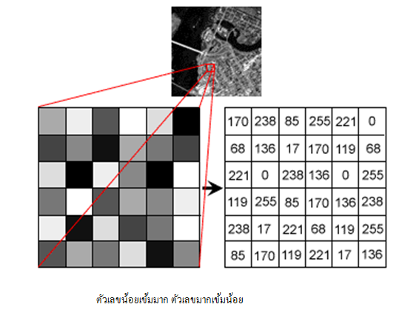
Characteristics of data from satellite images
Image data is assigned a specific location in the matrix in rows (row, i) and columns (column, j). The data in each location is a pixel, which is the smallest unit that makes up a two-dimensional image. Each point in row i and column j in the image has an associated brightness value (BV). This may be called the brightness value that is converted to this number. Digital number (DN)
Example of storing image data in a format8-bit numerical data (256 levels)
Center of Excellence in AI and Emerging Technology
Center of Excellence in AI and Emerging Technology

Slide 6
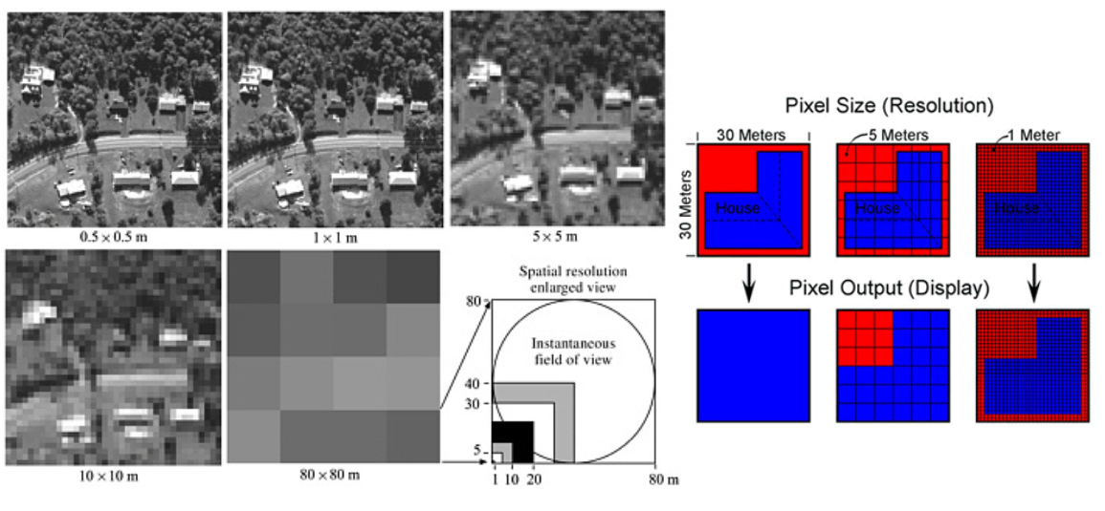
Characteristics of data from satellite images
Center of Excellence in AI and Emerging Technology

Slide 7
Characteristics of data from satellite images
Spectral resolution refers to the specific wavelength range in the electromagnetic spectrum that a measuring instrument can record, such as band 1 of the Landsat satellite measuring instrument and Thematic Mapper (TM) systems. It records energy between the wavelengths of 0.45-0.52 microns in the visible spectrum of the spectrum.
Spatial resolution refers to the size of the smallest object that can be clearly separated by a measuring device or the ability to display the ground area in each image point. Higher spatial resolutions have smaller numbers. For example, a spatial resolution of 79 meters is coarser than a spatial resolution of 10 meters. Spatial resolution is related to the scale of the image.
Radiometric resolution refers to the number of possible data file values in each wavelength. Radiological resolution is indicated by the number of bits, which are the energy values, that are divided into parts of a recording, for example in 8-bit data, the data file ranges from 0 to 255.
Temporal resolution refers to the repeatability of a measuring instrument. Record images in the same area. For example, Landsat satellites can repeat images of the same area around the world every 16 days, while SPOT satellites can repeat images of the same area every 26 days
Center of Excellence in AI and Emerging Technology

Slide 8
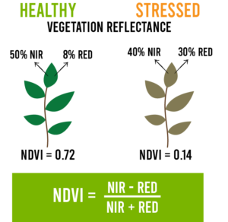
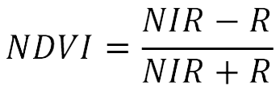
Analyzing satellite images using index
Near Infrared (NIR) wavelength range is 0.76 -0.90 micrometers and the benefits of NIR are the study of plants and the separation of soil and water.
The red light wave range (Red) refers to the wavelength range of 0.60 – 0.70 micrometers.
NDVI (Normalized Difference Vegetation Index) or Vegetation Difference Index means the ratio between the difference in the amount of energy reflection in the near infrared (NIR) wavelength and the amount of energy reflection in the red light wavelength to the sum of the amount of Reflects energy in the near infrared (NIR) wave range and the amount of energy reflected in the red light wave range.
Center of Excellence in AI and Emerging Technology

Slide 9
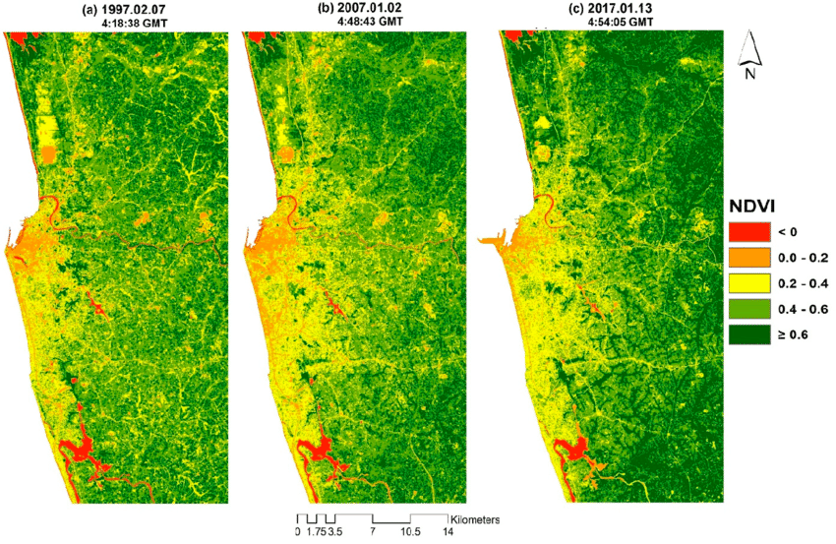

Center of Excellence in AI and Emerging Technology

Slide 10
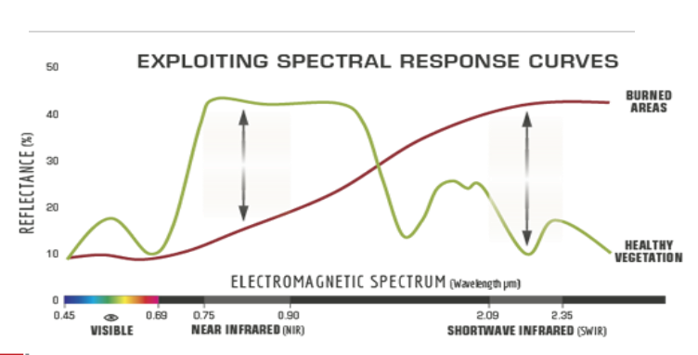
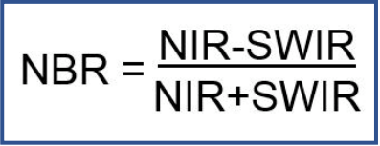
Normalized Burn Ratio(NBR)
Short-wave infrared (SWIR) has a distinctive feature of being able to penetrate through fog, smoke, and dust, making it possible to interpret areas even when obscured by fog or smoke. CAVIS is another outstanding band of WorldView-3 that never have any commercial satellite existed before. It suitable for inspecting areas where there are clouds, snow, water vapor, or aerosol. The benefits of SWIR are the study of land use and minerals.
The normal burning equation is an equation that indicates the area of a wildfire that can be calculated from the near infrared (NIR) and short wavelength (SWIR) bands. The calculation equation is as follows.
Center of Excellence in AI and Emerging Technology

Slide 11
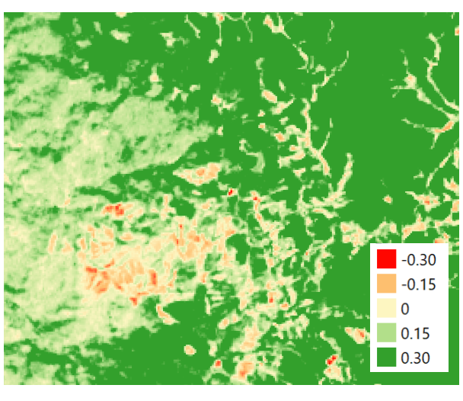
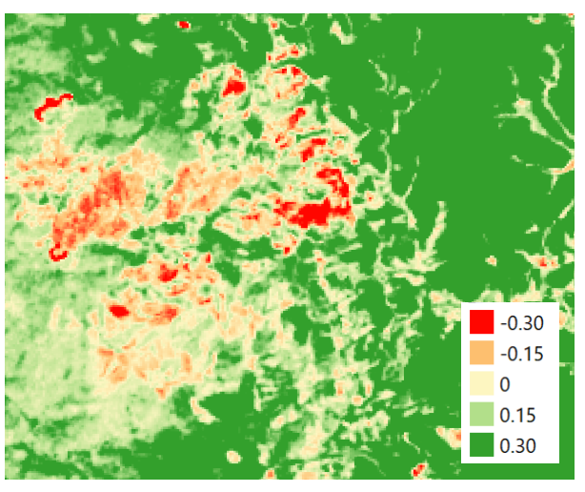
NBR data before the forest fires
Sentinel-2 March 10, 2020
NBR data after the forest fire
Sentinel -2 March 25, 2020
Center of Excellence in AI and Emerging Technology

Slide 12
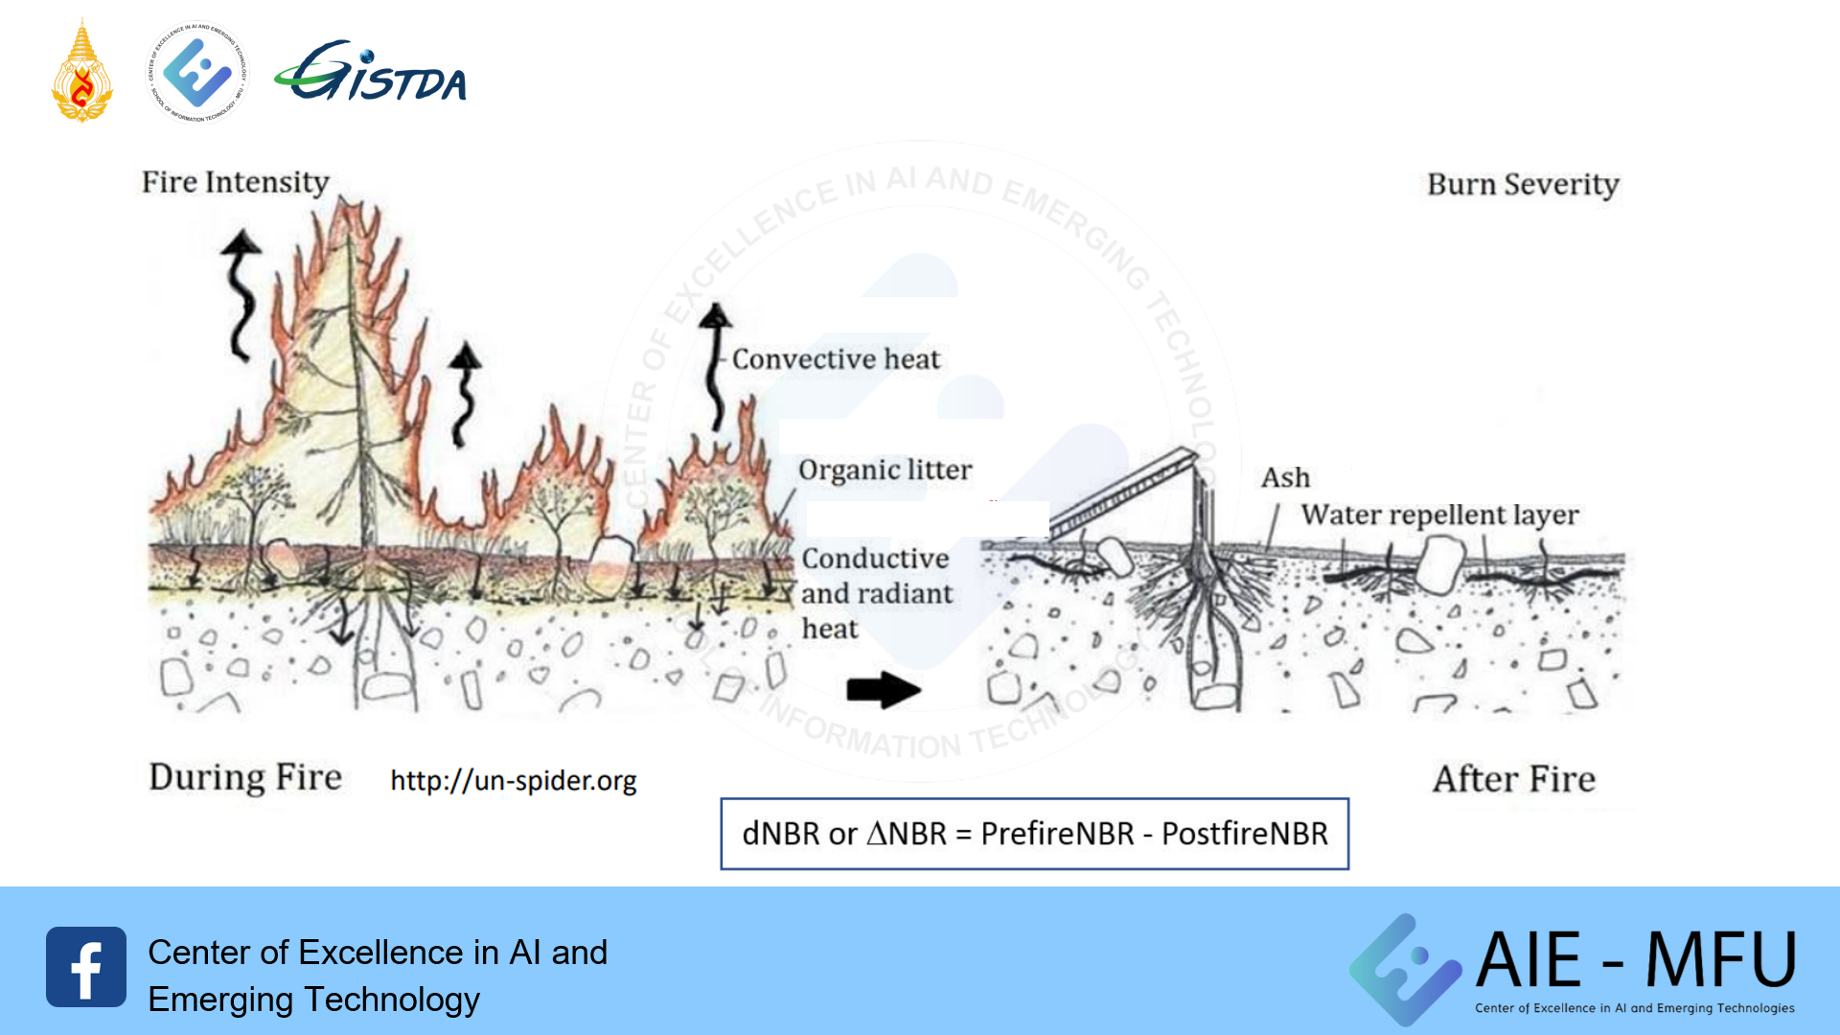
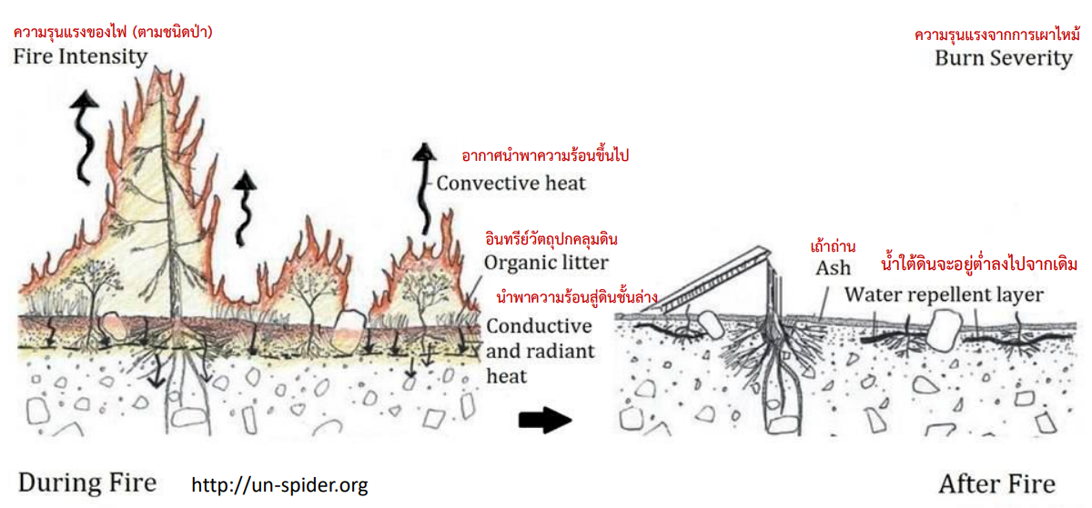
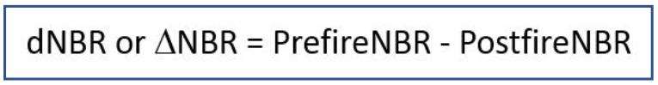
Center of Excellence in AI and Emerging Technology

Slide 13
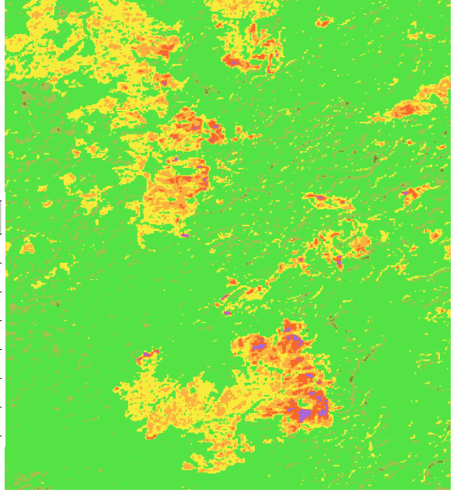
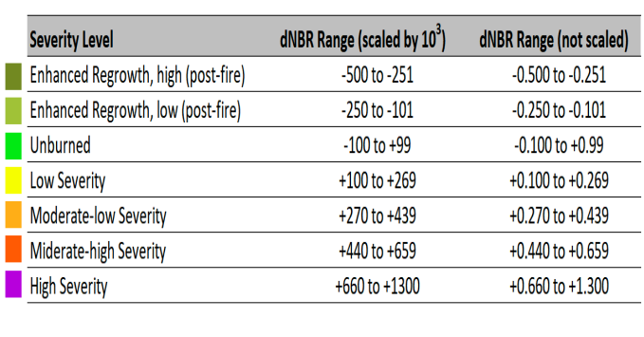
Classification of burn severity
Center of Excellence in AI and Emerging Technology

